Slide 1
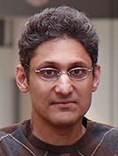
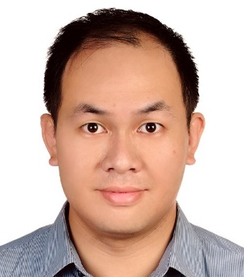
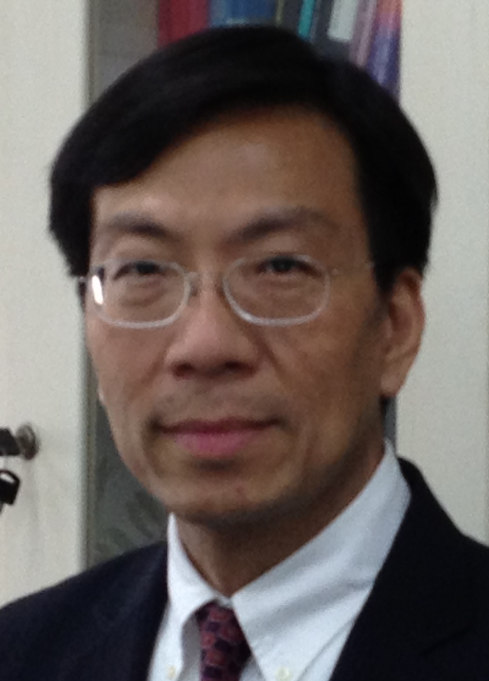
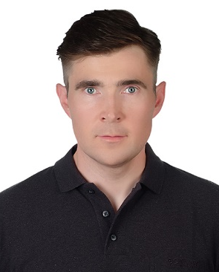
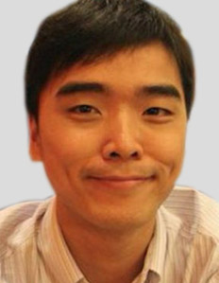

Algorithm/Architecture Co-design for Artificial Intelligence: From System-on-Chip to Internet-of-Things and
Neuromorphic/Cloud/Edge
Nov. 02, 2017(Thu.)
Agenda of the workshop
 | Registration
 | Topic: Algorithm/Architecture Co-design: From System-on-Chip to Internet-of-Things and Neuromorphic/Cloud/Edge Speaker: Prof. Gwo Giun Lee Dept. of Electrical Engineering, National Cheng Kung University
 | Topic: Design and Implementation of Multicore Signal Processing Systems Speaker: Prof. Shuvra Bhattacharyya Dept. of Electrical and Computer Engineering, University of Maryland College Park
 | Coffee Break
 | Topic: A Novel SPICE-Based Simulation Platform for Deep Learning AI Hardware Speaker: Prof. Darsen Lu Dept. of Electrical Engineering, National Cheng Kung University
 | Topic: Learning in Man and Machine Speaker: Prof. Martin Nordling Dept. of Mechanical Engineering, National Cheng Kung University
 | Topic: Industrial Defect Inspection from scratch to production Speaker: Dr. Andrew Liu Deep Learning Solution Architect, NVidia Taiwan
13:00-
13:30
13:30-
14:10
14:10-
14:50
14:50-
15:10
15:10-
15:50
15:50-
16:30
16:30-
17:10
Prof. Shuvra Bhattacharyya
Professor, Department of Electrical and Computer Engineering, University of Maryland College Park
Visiting Professor, Tampere University of Technology
Prof. Darsen Lu
Assistant Professor, Department of Electrical Engineering, National Cheng Kung University
Former Research Scientist at IBM Thomas J. Watson Research Center
Prof. Gwo Giun Chris Lee
Professor, Department of Electrical Engineering
Director of Bioinfotronics Research Center, National Cheng Kung University
Former System Architect at Philips Semiconductor, USA
Prof. Martin Nordling
Assistant Professor, Department of Mechanical Engineering, National Cheng Kung University
Founder of Nordron Inc. in Sweden
Ph.D., KTH Royal Institute of Technology, Sweden
Dr. Andrew Liu
Deep Learning Solution Architect, NVidia Taiwan
活動時間 : 2017/11/02(四) 13:00-17:10
活動地點 : 國立成功大學自強校區電機工程系館1樓靄雲廳
報名網址: https://goo.gl/forms/yV4UJ93NfVbkVjOs2
聯絡人: 李國君教授助理 Emily Liu ext. 62400-2850 Email: ncku.msoclab@gmail.com
承辦單位: 成大生醫資訊電子研究中心
Bioinfotronics Research Center

